Slide 1
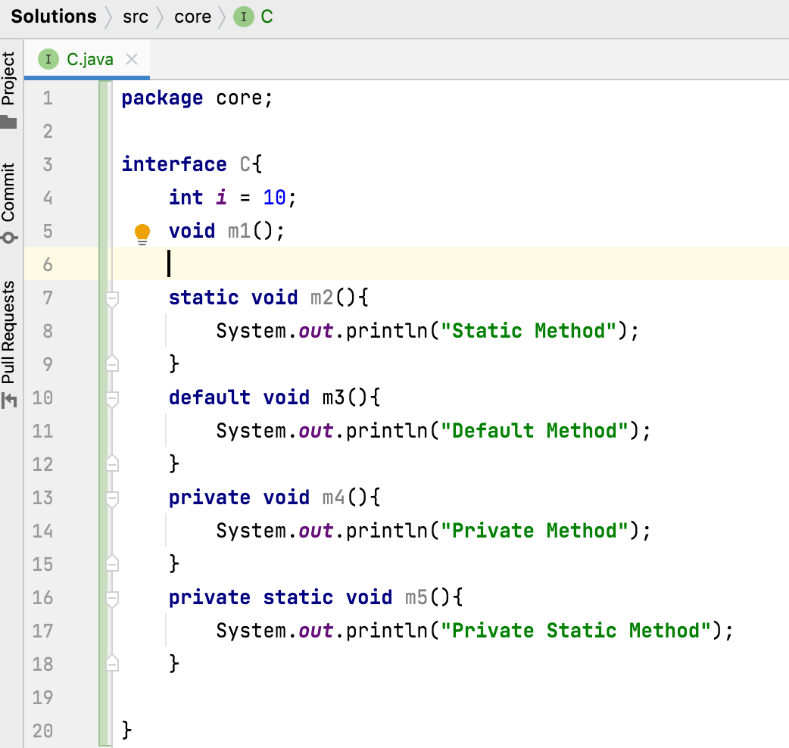
Can interfaces have static methods?
Yes.
Interface methods:
Before Java 8 : Public , abstract
From Java 8 : Static , Default
From Java 9 : private , private static

